Slide 1

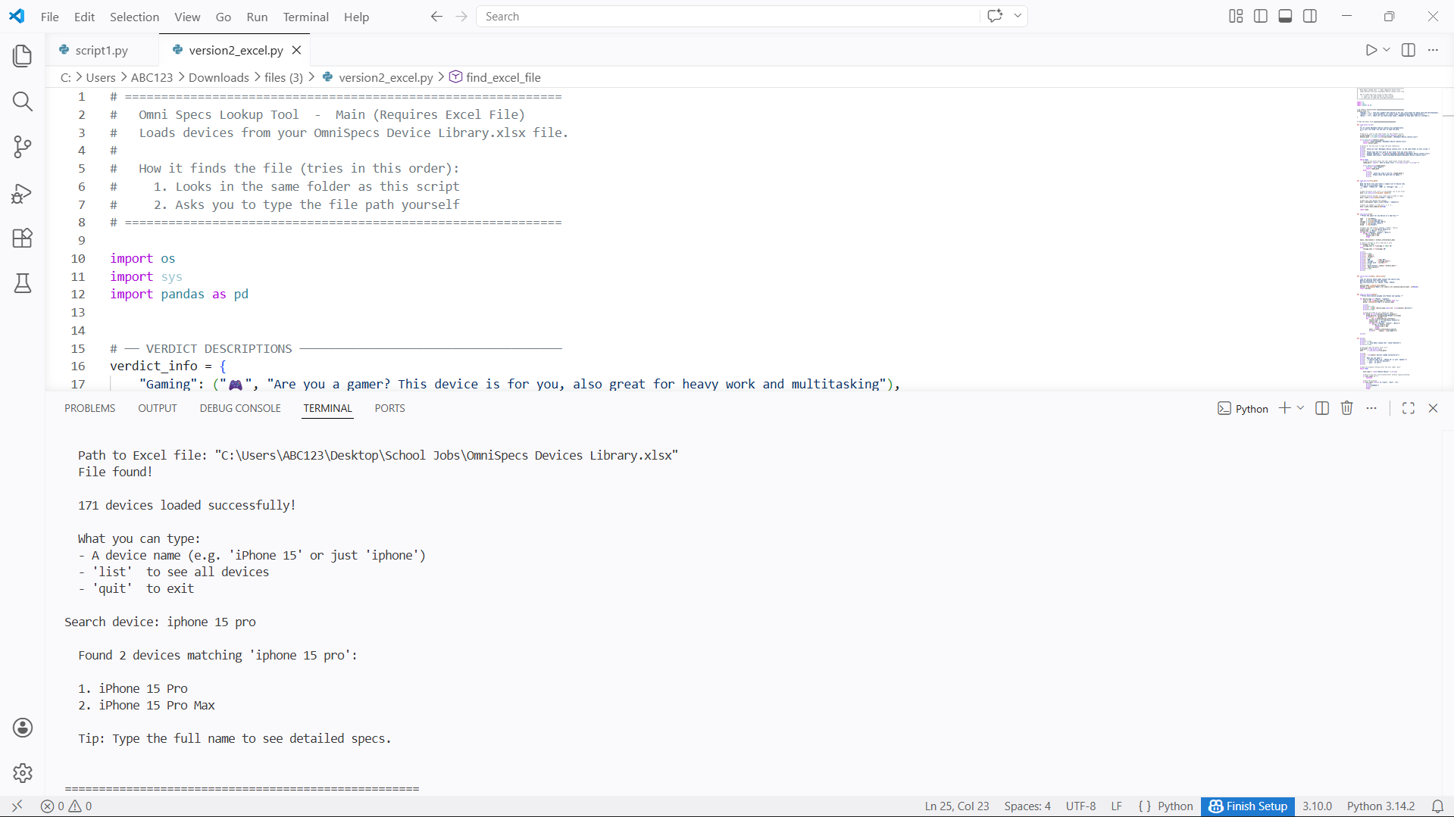

GitHub Link
https://github.com/ksu-is/OmniSpecs
2026
Omni
Specs
“Get device specifications without the internet...”
Presented by
Gerald Onwudinjo

